Slide 1

Project Lighthouse
MySkool
Transformation Through Education
Presented by Dhaniyal Mohammed Shahid.
Copyright Edunext School Services - 2024-2025

Slide 2

Education
MySkool
The word "education" has its roots in the Latin word *educatio*, which comes from *educare*, meaning "to rear, to bring up, to educate." The prefix *e-* means "out" or "from," and *ducere* means "to lead." Thus, *educare* can be interpreted as "to lead out" or "to draw out," reflecting the idea of nurturing and developing a person's potential.
Over time, the term evolved through Old French and Middle English before settling into its modern form in English. The concept of education encompasses not only formal schooling but also the broader process of learning and personal development.

Slide 3

Lighthouse for Education
MySkool
"Lighthouse for Education" refers to MySkool’s various initiatives and programs aimed at guiding students and educators toward success and accomplishment.
It not only involves providing resources, support and innovative strategies to improve learning outcomes. But also standing tall and bright as lighthouse in the midst of darkness guiding lost souls home.

Slide 4
Safe harbour
MySkool
DISCLAIMER
This Presentation has been prepared by Edunext for its prospective clientele and partners, solely for informational purposes. This document contains forward-looking statements which involve substantial risks and uncertainties. The information contained herein has been prepared to assist prospective clienteles in making their own evaluation of the Company and does not purport to be all-inclusive or to contain all of the information a prospective or existing clientele may desire. In all cases, interested parties should conduct their own investigation and analysis of the Company and the data set forth in this information. Edunext makes no representation or warranty as to the accuracy or completeness of this information and shall not have any liability for any representations (expressed or implied) regarding information contained in, or for any omissions from, this information or any other written or oral communications transmitted to the recipient in the course of its evaluation of the Company.
This Information includes certain statements and estimates provided by the Company with respect to the projected future performance of the Company. Such statements, estimates and projections reflect various assumptions by management concerning possible anticipated results, which assumptions may or may not be correct. No representations are made as to the accuracy of such statements, estimates or projections. Prospective clienteles will be expected to have conducted their own due diligence investigation regarding these and all other matters pertinent to investment in the Company.
This presentation may contain statements that are not historical facts, referred to as “forward looking statements.” The corporation’s actual future results may differ materially from those suggested by such statements, depending on various factors. Risks that contribute to the uncertain nature of the forward-looking statements include, among others, risks associated with developing and delivering products and services to address the rapidly evolving market for Digital Ordering, payments and point-of-sale, financial, and marketting services; the Company’s ability to expand its product portfolio and market reach and deal with the substantial and increasingly intense competition in its industry.
The Company’s ability to retain existing sellers, attract new sellers, and increase sales to all sellers; changes to the rules and practices of payment card networks and acquiring processors; the Company’s history of generating net losses; possible fluctuations in the Company’s results of operation and operating metrics; and the effect of management changes and business initiatives. All forward-looking statements are based on information and estimates available to the company at the time of this letter and are not guarantees of future performance. Except as required by law, the Company assumes no obligation to update any of the statements in this document.

Slide 5
Changing Paradigm
MySkool
Shift in education approches :
Pandemic Impact: The COVID-19 pandemic accelerated the adoption of online and hybrid learning models. Many schools implemented remote learning, leading to both challenges and opportunities in digital education. The most significant drawback being children addiction to gadgets and reduction of their learning abilities.
Digital Divide: Access to technology and the internet acting as a double edged sword, with many students lacking the understanding of using it for effective online learning has hampered the growth of an entire generation.
Curriculum Evolution: Schools are unable to revise their curriculum to include critical thinking, creativity, and real-world problem-solving, moving away from rote memorization as the education system is controlled by the Government bodies.
Slow Teacher Adaptability: Educators are slow in adapting to new teaching methods, utilizing technology to enhance engagement and interaction in the classroom, with the concentration span of the students drastically low the immersion of knowledge is at the lowest point.
Parental Involvement: Parents have very less role today in their children's education, often taking on a more tried and tested routes to ensure their child completes the formal education for securing the future of the child. In the process hampering the natural learning potential and growth.
Overall, the current educational landscape is marked by complexity and resilience, as stakeholders striving to navigate the complexities of learning in a rapidly changing world.

Slide 6
Future trends of education
MySkool
Innovation that are key to shape the children’s future :
Blended Learning Environments: A combination of online and in-person instruction will become more prevalent. This approach allows for flexibility, making education accessible to a broader range of students.
STEM and STEAM Education: There will be a greater emphasis on science, technology, engineering, arts, and mathematics, preparing children for a future job market that values creativity and technical skills.
Lifelong Learning Mindset: Education will extend beyond traditional schooling, encouraging a mindset of continuous learning and adaptability, which is crucial in a rapidly changing world.
Emphasis on Social-Emotional Learning (SEL): Schools will increasingly focus on developing students' emotional intelligence, resilience, and interpersonal skills, recognizing their importance for overall well-being and success.
Focus on Critical Thinking and Problem Solving: Curriculums will prioritize skills like critical thinking, creativity, and problem-solving over rote memorization, preparing students for real-world challenges.
These trends suggest a more dynamic, inclusive, and holistic approach to education, aiming to equip children with the skills they need for the future.

Slide 7
Adoptable measures in currant scenario
MySkool
To effectively address the current scenario in education, several adaptable measures can be implemented:
Training for Educators: Provide ongoing professional development for teachers to enhance their literacy and pedagogical skills, ensuring they can effectively use new methods & technology in the classroom.
Flexible Assessment Methods: Shift towards more diverse assessment strategies that consider students' unique strengths, such as project-based learning and portfolio assessments, rather than solely standardized testing.
Curriculum Updates: Regularly revise curriculum to include relevant real-world skills, critical thinking, and creativity, preparing students for future challenges.
Parental Engagement Initiatives: Create platforms and resources that encourage parental involvement in education, fostering communication between schools and families to support student learning.
Social-Emotional Learning (SEL) : Integrate SEL into the curriculum to support students' mental health and emotional well-being, helping them develop resilience and interpersonal skills.
Hybrid Learning Models: Develop flexible learning environments that combine in-person and online instruction, allowing for greater accessibility and accommodating different learning preferences.
By adopting these measures, educators and policymakers can create a more inclusive, flexible, and supportive educational environment that meets the needs of all students in the current scenario.

Slide 8
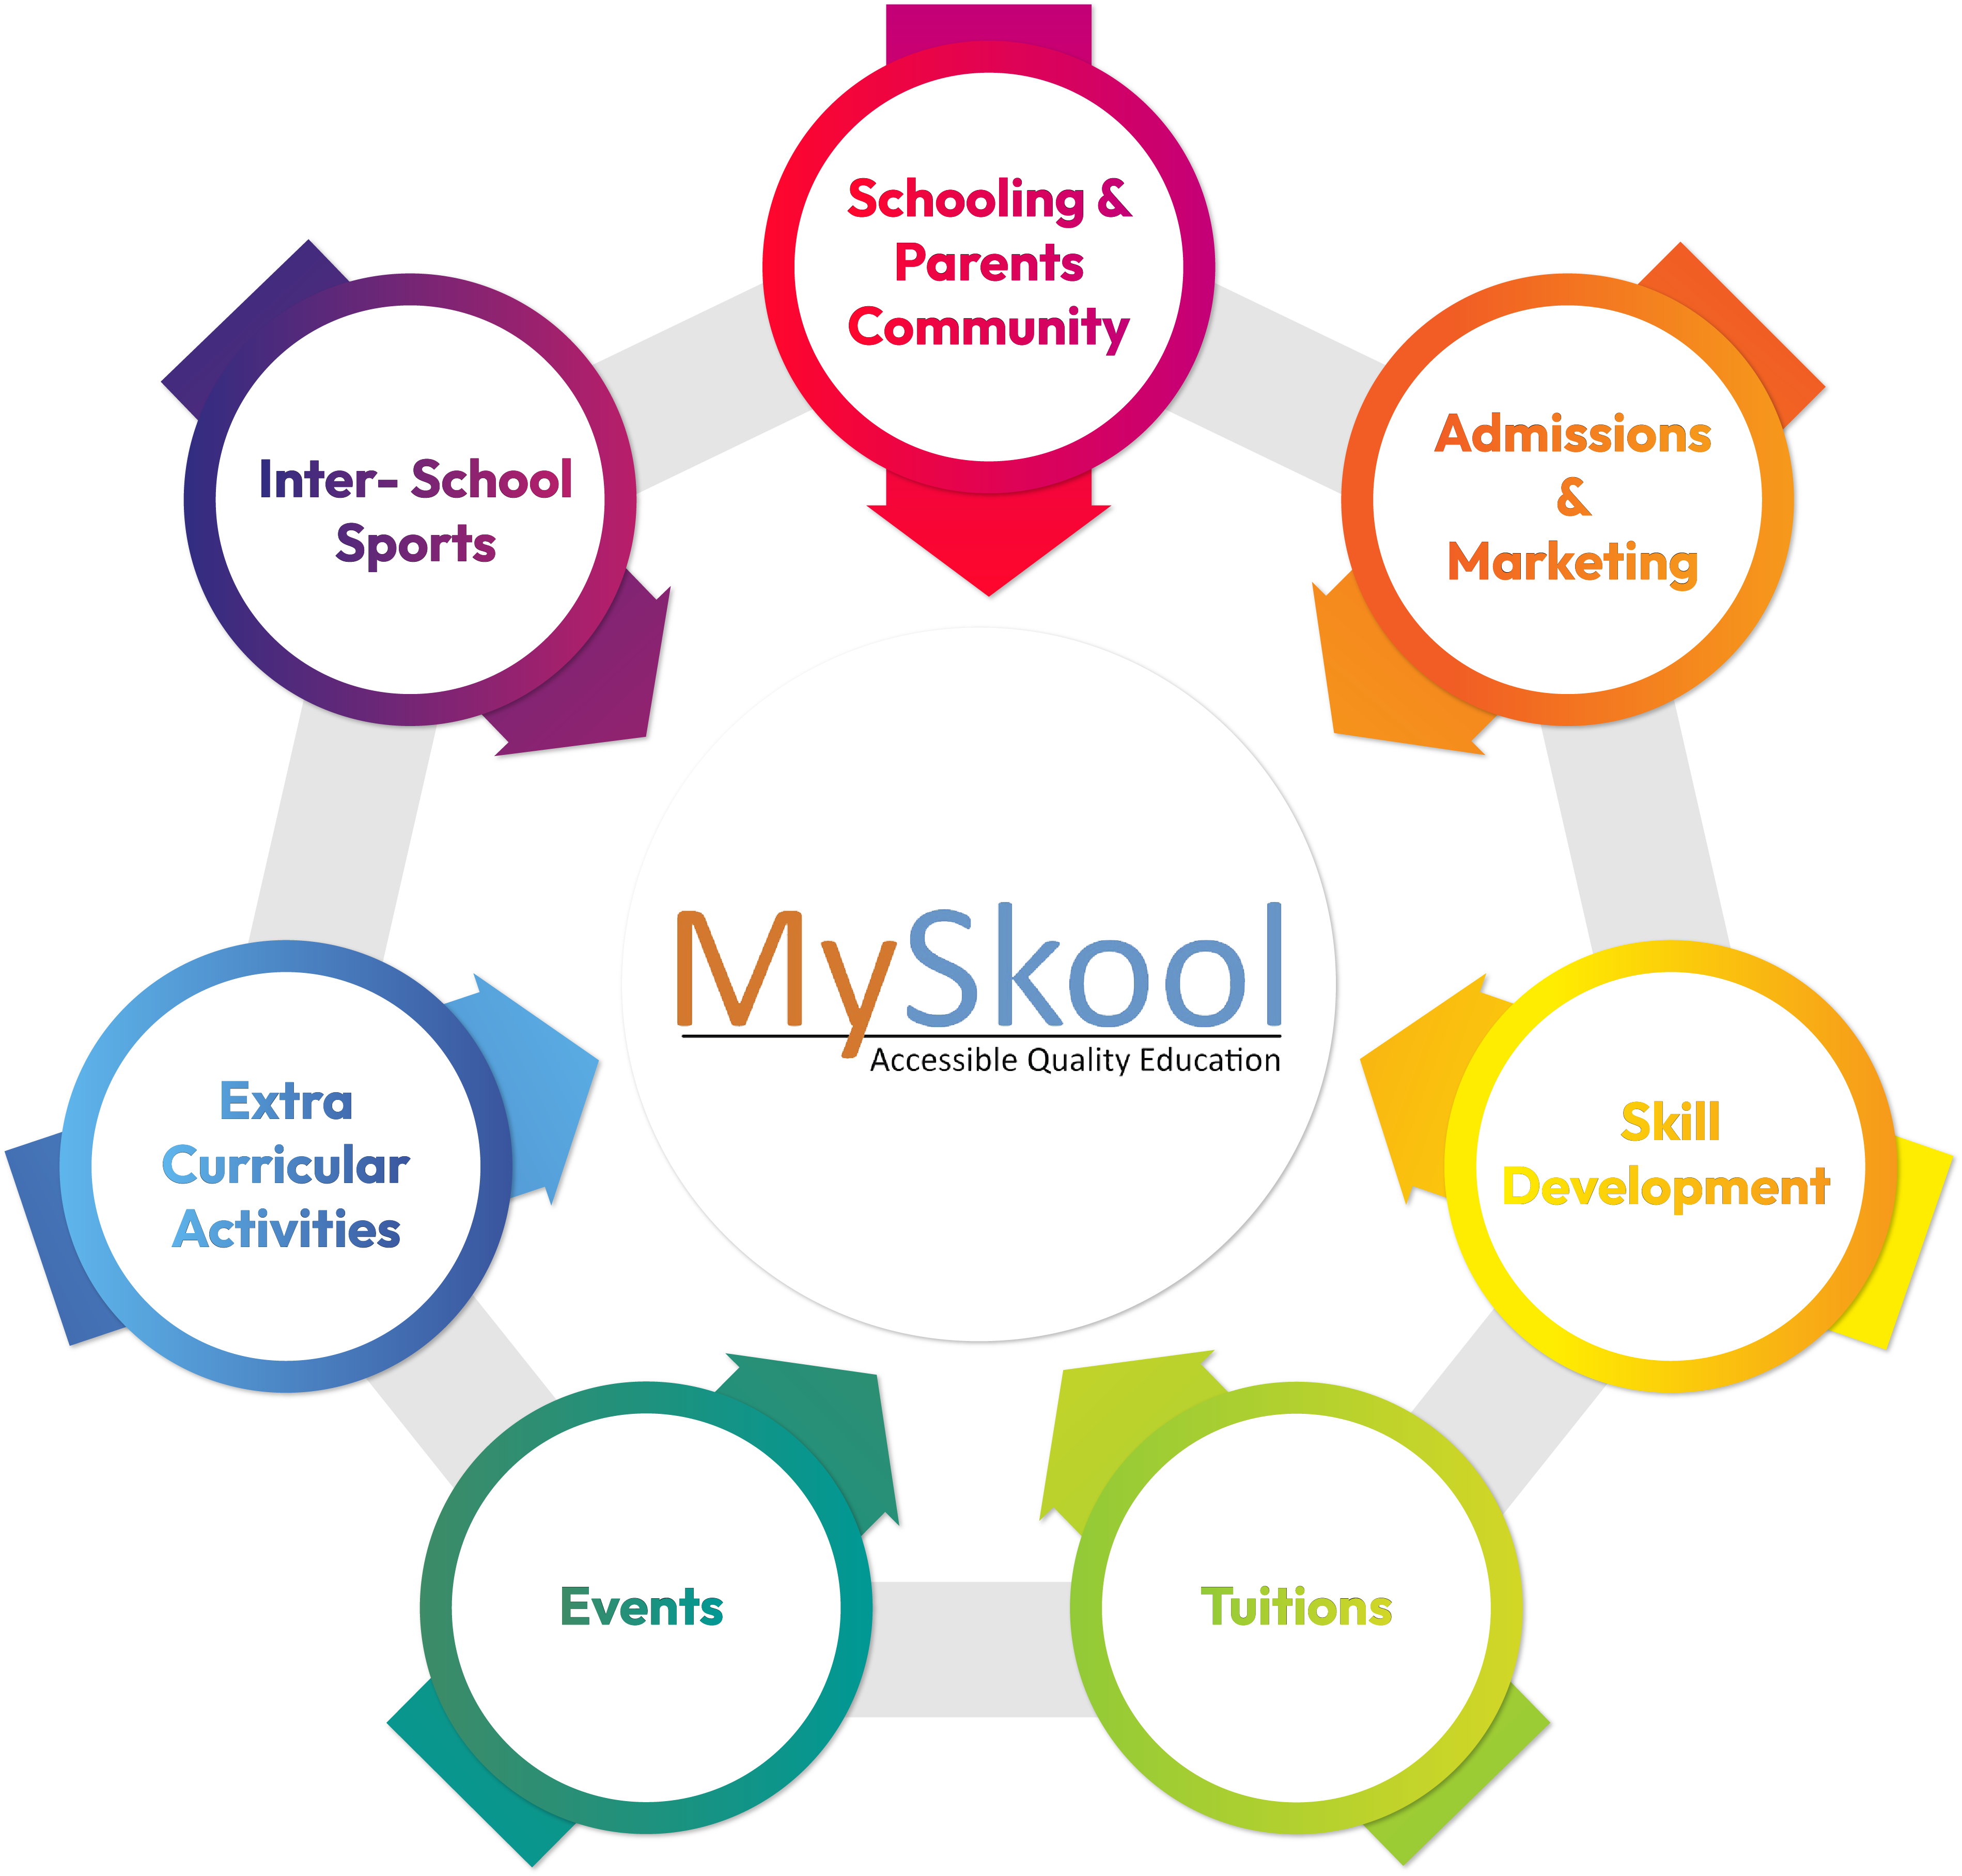
MySkool
Montessori
Holistic
Development
New Era
VISION
PreSkool

Slide 9

MySkool
Its not Just Education
Its an Environment
A school to a child is what soil is to a plant. Just the way only the right soil can help a plant grow upto its peak, the right school can help a child grow upto his/her maximum potential.

Slide 10
MySkool Eco System
MySkool
MySkool aspires an eco system to create a truly inclusive system of education that encompasses all type and class of children to give a real inclusive educational experience for children in the future.
1. MySkill Club
2. MySkool Collab
3. My PreSkool
4. MySkool Club
5. MySkool Hybrid Schooling
6. BS International Schools
7. Global Life University - Skill University

Slide 11

MySkool
Skilled trainers play a crucial role in the educational system and have a profound impact on students’ lives. Skilled trainers are essential for creating a positive learning environment, promoting academic success, and shaping the future of their students. To create a pool of skilled trainers MySkill trains and grooms the best talent.

Slide 13
MySkill
MySkool
MySkill - Empowering womanhood, is program with a vision to give a platform to all the women for diversifying their existing skills to meet today's challenges. MySkill aims at building actual competencies to achieve their highest desired level of independence and inclusion in their communities.
MySkill has partnered with institutes who have a proven track record of training and empowering women through various educational and experiential learning in the past. MySkill offers a platform for all aspiring women who want to have a greater expansion in professional and personal growth which in turn contribute to structural transformation and economic growth by enhancing employability.

Slide 14
Why Skilled Trainers?
MySkool
Here are some key reasons why skilled trainers are important :
1. Facilitating Learning : Skilled trainers employ effective teaching methods that cater to diverse learning styles, helping students grasp complex concepts.
2. Building Relationships : They foster strong relationships with students, creating a supportive and safe environment that encourages open communication and engagement.
3. Encouraging Critical Thinking : SKilled trainers challenge students to think critically and independently, preparing them for real-world problem-solving.
4. Motivating Students : Skilled trainers inspire and motivate students to achieve their potential, instilling a love for learning and curiosity.

Slide 15
Why Skilled Trainers?
MySkool
Here are some key reasons why skilled trainers are important :
5. Adaptability : They can adapt their strategies to meet the varying needs of students, ensuring that all learners can succeed.
6. Assessment and Feedback : Skilled trainers provide constructive feedback and assessments that guide student progress and help them understand their strengths and areas for improvement.
7. Mentorship : They serve as mentors, guiding students not only academically but also in personal development and life skills.
8. Community Builders : Skilled trainers often engage with families and the community, fostering a collaborative approach to education.

Slide 16
Benefits for Trainers
MySkool
Contribute just 1-2 hours of time daily, and earn upto 30k to 50k.
Complete training will be provided by MySkill team.
Every trainer will be certified.
Regular worshops and review sessions will help in continous
learning and upgrading of knowledge.
Free Day care facility during teaching hours at MySkool branches.
Learn, Earn and feel Empowered

Slide 17

MySkool
Collab - Meaning to collaborate which is the very need of this generation children who are intrigued to gadgets fail to socialize and have normal human interaction.

Slide 18
Collab
MySkool
With the introduction of Collab, MySkool ensures the humanly interaction developing all aspects of human evolution.
The generation of inborn talents with technology has overpowered human interaction especially in children leading to virtual autism ( addiction to mobile and disconnect from real world), anti social behaviour and more. With courses like Personality development, Linguistics, ECE etc MySkool contributes the changing lives for better.
With every course tailor made to suit the age of children and activities to ensure knowledge in not just imparted but also ensures immersion of knowledge takes place, MySkool ensure parents parents involvement passively in the growing years and facilitating the moulding of children.

Slide 19
Potential of Collab
MySkool
According to society management apps in India, more than 50000 societies in 27 cities are within the parameters set below,
Society with more than 150 Units
Society with average rental of Rs. 20000 per month
Society with facility like club house / party hall to conduct classes

Slide 20
Parameters for Society Onboarding
MySkool
According to society management apps in India, more than 50000 societies in 27 cities are within the parameters set below,
Society with more than 150 Units
Society with average rental of Rs. 20000 per month
Society with facility like club house / party hall to conduct classes

Slide 21

MySkool
Preskool children have an instinctive desire to learn, discover and try new things. Their natural curiosity is attracted to anything they are unfamiliar with, so that makes children interested in trying everything.

Slide 23

MySkool
Gone are the days where only academics used to be the focus point of development. Today, co-curricular, extra- curricular and academics go hand in hand for an individual to be successful. While schools do have activities besides academics, children need more!

